Slide 1
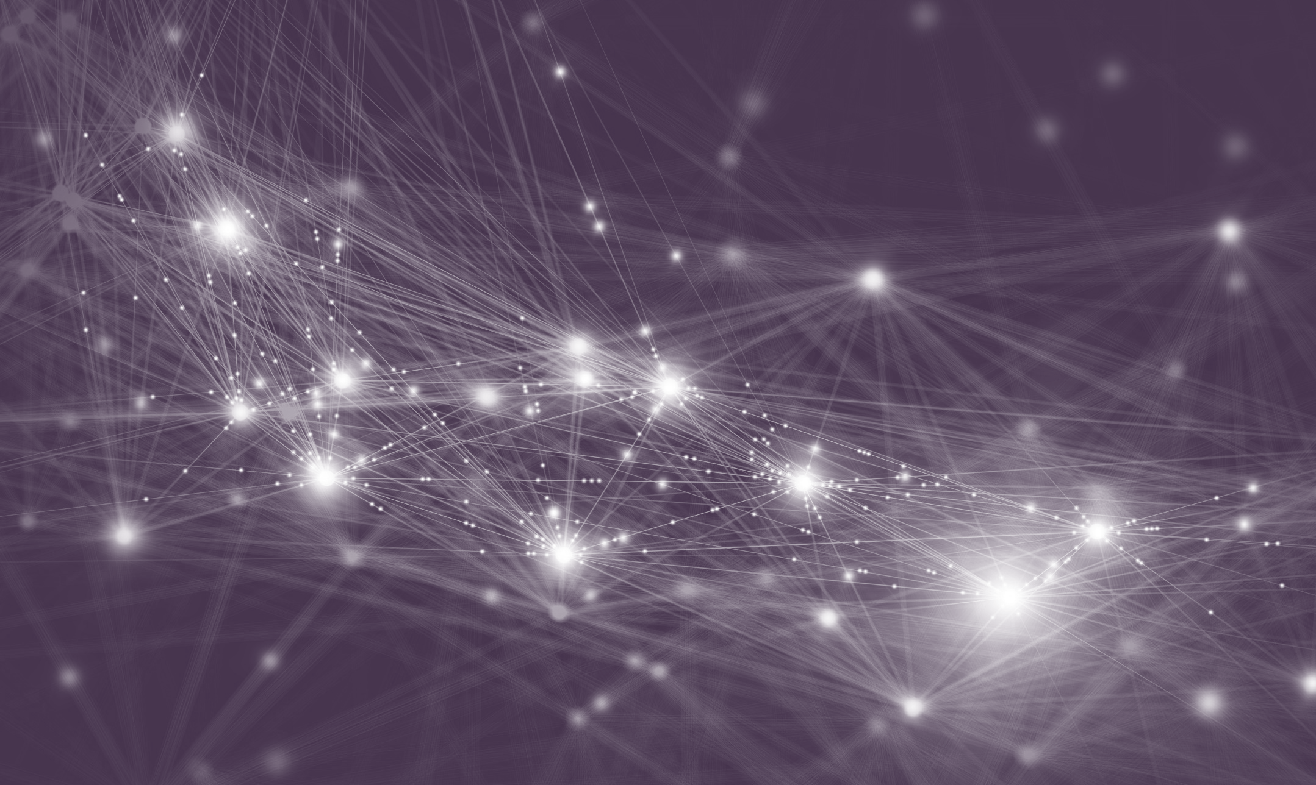

Empowering Citizens against Covid-19 with an ML-Based and Decentralized Risk Awareness App
Yoshua Bengio
with help from dozens of others
May 1st, 2020

Slide 2
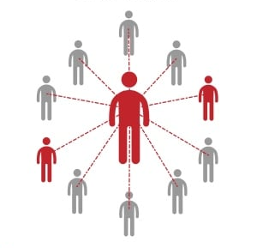
Why Contact Tracing?
Identify contacts of diagnosed individuals and ask them to self-isolate
Classical method: manual tracing based on interviews and phone calls
Can stop the propagation of the virus if done perfectly
But it is sufficient to reduce R_{t} to below 1
Empowering Citizens against Covid-19 with an ML-Based and Decentralized Risk Awareness App

Slide 3
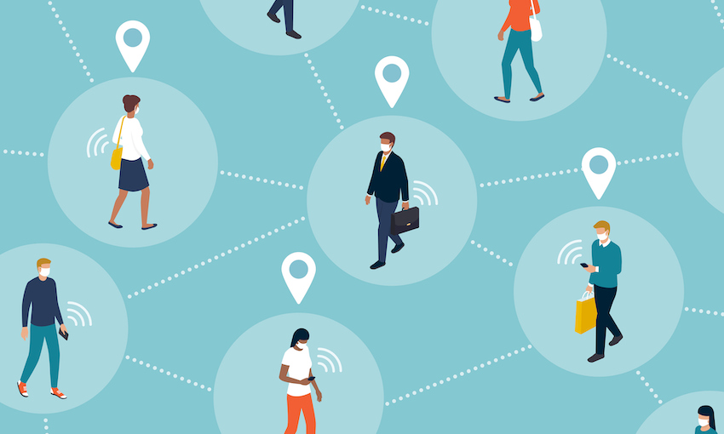
Why Digital Contact Tracing?
Limitations of manual tracing compared to mobile phones digital tracing:
Covid-19 is most contagious pre-symptomatic (not detected by manual contact tracing)
Poor coverage of population (& not all contacts are with known persons)
Delay of days
Advantage of manual tracing:
Human tracers use their judgement, can integrate many clues, including ones not observed by a phone
Could ML-based digital tracing also integrate many clues to identify highest risks? (Best of both worlds)
Empowering Citizens against Covid-19 with an ML-Based and Decentralized Risk Awareness App

Slide 4

Why ML-Based Risk Estimation?
Standard tracing (manual or digital) is binary and brittle: contact or no contact?
In reality, many clues should be integrated before taking a decision about the risk level of a person:
Symptoms
Prior medical conditions
Age, biological sex
Risk levels of all the contacts, and when these happened
ML can be used to predict the infection status probability distribution, given these clues
Provides early warning signals, well before standard tracing (digital or manual) would raise a flag
These signals and other information from the app can empower manual contact tracers to make informed decisions
Empowering Citizens against Covid-19 with an ML-Based and Decentralized Risk Awareness App

Slide 5
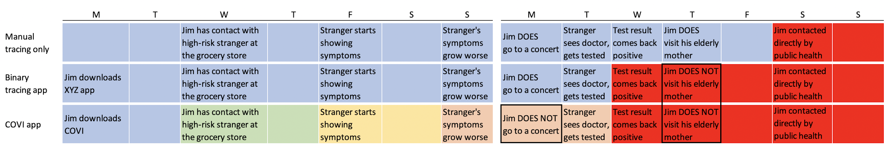
Early Awareness Saves Lives
ML estimators can aggregate many weak clues, then warn a user that their risk has increased well before they would otherwise get contacted by public health manual tracing.
Studies have shown that people change their behavior drastically and self-isolate as soon as they suspect they might be contagious.
Early awareness would reduce the number of contagious contacts and the rate of spread of the virus.
Empowering Citizens against Covid-19 with an ML-Based and Decentralized Risk Awareness App

Slide 6

Why a Privacy-First Design?
Wide adoption is necessary for significant impact
Main concern of citizens is privacy
It is possible to obtain strong privacy while enabling contact tracing and risk awareness propagation
Two main concerns:
Third party anonymity: others should not know my risk or personal data
Privacy wrt authorities: governments should not know my trajectory or contact graph
We use a Mixnet cryptographic protocol making it possible for two phones (or one phone and a central server) to exchange risk messages without each other knowing who the message comes from, nor exactly when and where the contact took place
Empowering Citizens against Covid-19 with an ML-Based and Decentralized Risk Awareness App

Slide 7

Social, Ethical & Governance Considerations
Human rights include:
Privacy
Safety and freedom
Dignity, avoid stigmatization
This would not be compatible with an app which
Tells us we cross path with somebody probably infected
Tells us that infected people are frequently at some location
(even if it would be tempting purely from the health point of view)
Data should be shared only with well-informed consent
Users should be able to ask that their data be removed from the database
Old data removed after three months or the end of the epidemic
Managing these issues and the data should be by an independent & non-profit data-trust
Empowering Citizens against Covid-19 with an ML-Based and Decentralized Risk Awareness App

Slide 8
Advantages for Public Health
Risk awareness for individuals: Personalized notifications occur as soon as the exposure risk increases, users will be empowered to act to protect their loved ones and their community. Important for deconfinement. Reduces the load on healthcare system. Integrate app with public health services, manual tracing and testing.
Epidemiological models: Identifying patterns and parameters of epidemiological models of how the virus spreads (e.g. distance, time, sex, age), to make better informed decisions based on evidence. A much lower sample size of population still provides enough data.
Scenario simulator: Public-health-specific interventions can be tested within the scenario simulator to assess the possible impact on disease transmission and viral spread. Public policies can be parametrized and optimized, e.g. for deconfinement strategies, to maximize number of days worked while keeping R₀ under a threshold.
Tailored measures: users will receive personalized and tailored recommendations implementing public health policy. Critical to support decision making on a daily basis by individuals and families as the range between the least-confining measure and the most-confining.
Holistic health: mental and physical health can be monitored with the app, directing citizens towards the appropriate information and resources.
Empowering Citizens against Covid-19 with an ML-Based and Decentralized Risk Awareness App

Slide 9
Behavioral Design
Uptake is crucial, need to focus on advantages for user, stickiness to remain useful
Population-level surveys and simulation to understand also citizens who do not download the app
Need mutual trust to succeed in a democratic society: power to decide in the hands of citizens
App is designed to help users access the relevant information (which is otherwise overwhelming)
Personal agency & empowerment: app designed to inform, allowing citizens to decide how to act upon this
User behaviors measured in-app, A/B testing, accessibility, and usability-centric design to provide better service
Avoid cognitive overload and desensitization
User comprehension is verified rather than assumed
Empowering Citizens against Covid-19 with an ML-Based and Decentralized Risk Awareness App

Slide 10
Design of a Risk Awareness App
Simple idea: predict test results, given all the available information on the phone.
Problems with that:
The input is a variable size set of contacts, plus answers to questions
Tests have false positives and false negatives (so we don’t observe ground truth)
What we want Alice to tell Bob (whom she met 8 days ago) is how contagious she probably was when they met, not whether she is infected now.
Alice might also want to tell Bob with what probability her evidence suggests that she got infected because of their meeting 8 days ago
We need to predict (unobserved) latent variables. How?
Empowering Citizens against Covid-19 with an ML-Based and Decentralized Risk Awareness App

Slide 11
Design of a Risk Awareness App
Similar to an expectation-maximization (EM) problem; more generally graphical models with latent variables Z and observed variables X
This requires not just a probabilistic model P(X,Z) from which we can sample events like contagion and symptoms and test results, but also an approximate inference mechanism Q(Z|X) from which we can infer Z given X.
Standard EM is not feasible because we do not have an analytic solution for P(Z|X)
Methods for iterative inference over latent variables like loopy-belief propagation require knowledge of the contact graph and propagation of too many bits of information (breaking our privacy constraints), and too many iterations to converge (which requires a lot of computation on the phone and a lot of bandwidth on the network).
We have now chosen amortized variational inference instead.
Empowering Citizens against Covid-19 with an ML-Based and Decentralized Risk Awareness App

Slide 12
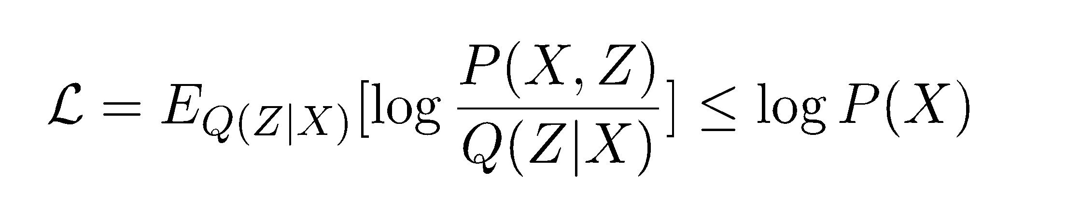
Amortized Variational Inference
Key principle behind Variational Auto-Encoders, on which Mila worked a lot
Optimize both P and Q wrt a single objective which is a lower bound on the data log-likelihood:
Similar to but more principled than - and can be combined with - the wake-sleep algorithm
For each X (e.g. from one phone), sample Z ~ Q(Z|X), then compute log P(X,Z), the compute its gradient wrt parameters of P and of Q, then update the parameters.
How to get this off the ground? First use an a priori epidemiological generative model P, then train the risk inference mechanism Q to be consistent with it, then acquire data X, then fit P and Q together as above.
Empowering Citizens against Covid-19 with an ML-Based and Decentralized Risk Awareness App

Slide 13
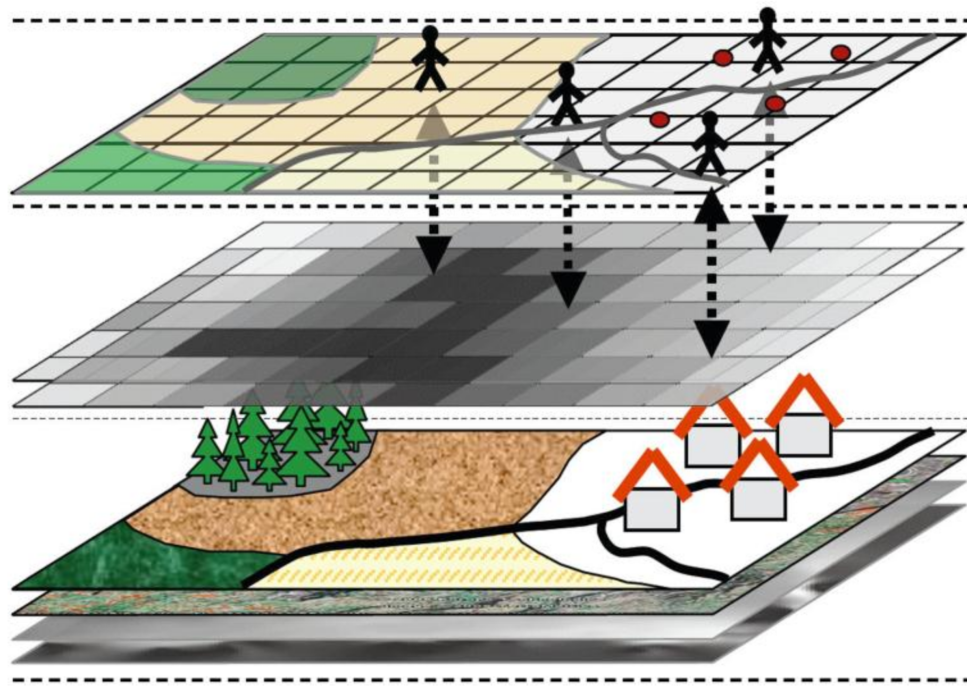
Epidemiological Generative Model
Stochastic agent-based model, implemented in Simpy
Population of humans moves around according to a mobility distribution and stochastically meets at locations, creating contacts (with duration and distance characteristics)
The mobility model captures the time spent in different types of locations (home, office, transportation, stores, hospitals, long-term care facilities, etc).
Humans can be in several discrete states (susceptible, exposed, contagious, recovered) and hold continuous state variables (e.g. viral load, contagiousness).
Symptoms stochastically arise due to flu/cold or Covid
Temporal evolution of contagiousness
Spread of the disease tracked via R₀ , attack rate etc
Parameters set or tuned to match known statistics
Individual characteristics & behaviour
Environmental & Demographic factors
Locations & Transportation information
Empowering Citizens against Covid-19 with an ML-Based and Decentralized Risk Awareness App

Slide 14
Epidemiological Generative Model
Human
Health
Age, Sex
Preexisting conditions (diabetes, heart disesase, asthma, etc.)
Has cold, flu, or allergies
SEIR timestamp
Symptoms
Viral load
Status
Travelled recently
Carefullness profile
Has app
Wearing mask
Infectiousness
Household, workplace
Mobility
Working hours & conditions
Shopping profile
Exercise profile
Transit profile
Environment
Time (2h chunks)
Events
Encounter between 2 humans
Human symptoms updated
Human test results updated
City
Graph structure
Locations
Events
Encounter
Human1, human2
Distance
Duration
Location contamination
Locations
Households, parks, stores, misc.
Contamination probability (depends on humans + material properties)
Mobility
Humans move around the city to different locations according to their mobility profiles
Empowering Citizens against Covid-19 with an ML-Based and Decentralized Risk Awareness App

Slide 15
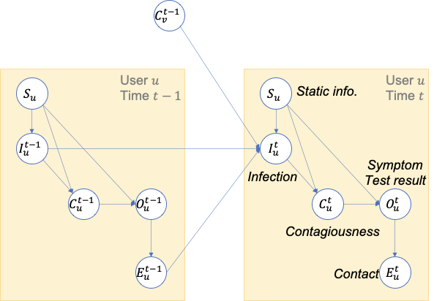
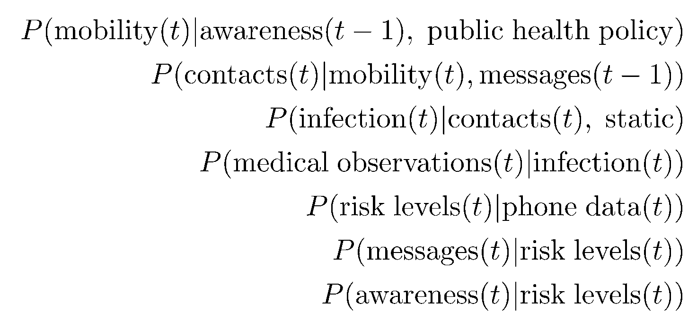
Epidemiological Generative Model
Very strong constraints on the structure of generative model P
Approximately known coefficients and statistics for many elements of the model, but could be greatly improved with access to large scale data, including capturing effect of suspected factors and their interactions.
The joint can be decomposed in many smaller and structured pieces. At a high level:
Empowering Citizens against Covid-19 with an ML-Based and Decentralized Risk Awareness App

Slide 16
Epidemiology Metrics
To ensure the simulator is representative of reality, we check many metrics
1. Demographics
Age and sex distribution (Canadian population) (Montreal population)
Average household size (Canadian population, by province?)
Rates of comorbidities in general population
Heart conditions and neurological conditions (i.e. CVD, stroke),
Diabetes, overweight/obesity,
Respiratory conditions (i.e. asthma, COPD)
Rate of flu/cold and seasonal allergies in general population
Empowering Citizens against Covid-19 with an ML-Based and Decentralized Risk Awareness App

Slide 17
Epidemiology Metrics
To ensure the simulator is representative of reality, we check many metrics
2. Epidemiology of COVID-19
Proportion of population infected by COVID (with positive test result)
Province level, city level, per household
Proportion exhibiting symptoms
Fever, fatigue, headache, trouble breathing, loss of taste, dry cough, sore throat, diarrhoea, muscle soreness/aches
Proportion asymptomatic
Age, Sex, High-risk groups (i.e. long-term residential care facilities, hospitals)
Proportion confirmed positive for COVID
PCR test
Tested but did not receive official results
No test, symptoms and contact with a case (presumed positive)
Proportion died (case fatality), Proportion recovered, Proportion of COVID cases hospitalized
Hospitalized in ICU (degree of severity)
Hospitalized and requiring mechanical ventilation (most severe, before death)
Empowering Citizens against Covid-19 with an ML-Based and Decentralized Risk Awareness App

Slide 18
Epidemiology Metrics
To ensure the simulator is representative of reality, we check many metrics
2. Epidemiology of COVID-19 (cont’d)
Probability of being infected by:
Age group,Sex, Recent international travel, Long-term residential care facility, Hospital, Community WorkplaceSchool/daycare, Public transportation/Ride shares
Average number of other people that person A will infect (Ro)
All Canadians (on average), Age group, Healthcare workers
Incubation time - persons infected with COVID
Time (days) person is in latent phase, Time (days) person is infected with COVIDTime (days) person is contagious
Proximity with COVID positive person
Distance to contact (<1m, 1-4m, 5-9m, 10+m), Time spent with contact (<15 min, 16-30 min, 31+ min)
3. Interventions
Social distancing
Proportion participating in social distancing (i.e. 70%, 80%, 90%)
Self-isolation
Proportion of epidemiologic contacts practicing social-isolation/quarantine
School closures (Time)
Wearing mask (Type of mask, i.e. cloth, surgical, N95)
Healthcare workers, General public (i.e. while shopping)
Empowering Citizens against Covid-19 with an ML-Based and Decentralized Risk Awareness App

Slide 19
Epidemiology Metrics
R0 = 2.55
Workplace
2.09
Senior Residency
1.77
School
1.55
Hospital
1.08
Serial Interval = 5.80 days
R
Asymptomatic
1.67
R
Presymptomatic
2.61
R
Symptomatic
1.25
Empowering Citizens against Covid-19 with an ML-Based and Decentralized Risk Awareness App

Slide 20
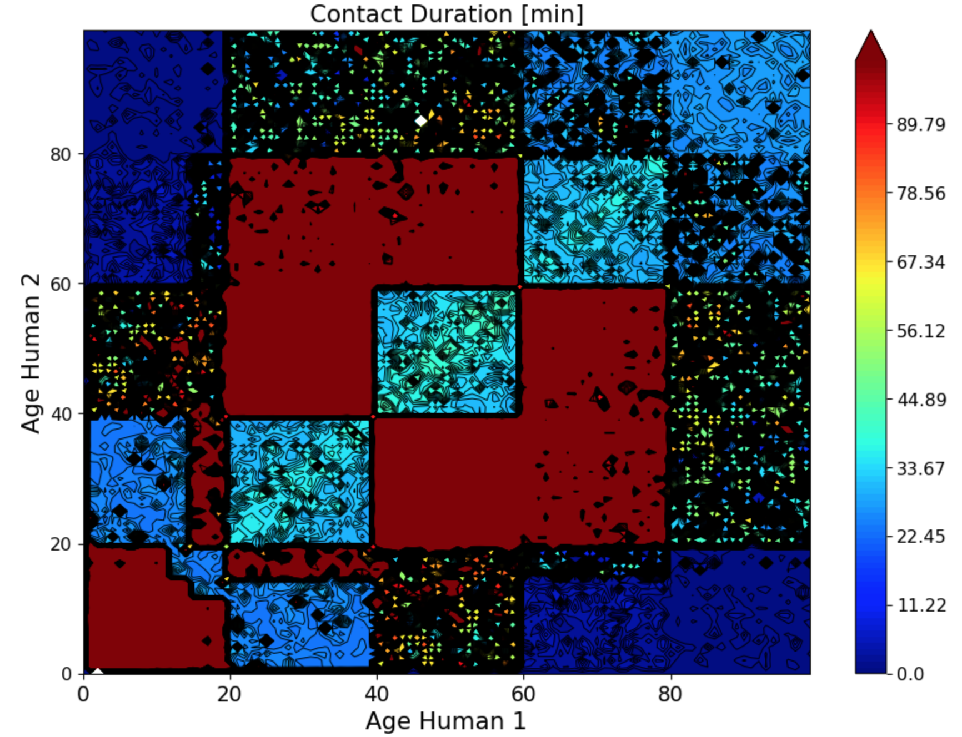
Epidemiology Metrics
Social mixing across the age groups
Empowering Citizens against Covid-19 with an ML-Based and Decentralized Risk Awareness App

Slide 21
Epidemiology Metrics
Age group | Average daily contacts
1 - 15 | 28.01
15 - 20 | 33.24
20 - 40 | 33.28
40 - 60 | 30.95
60 - 80 | 50.89
Above 80 | 45.92
Empowering Citizens against Covid-19 with an ML-Based and Decentralized Risk Awareness App

Slide 22
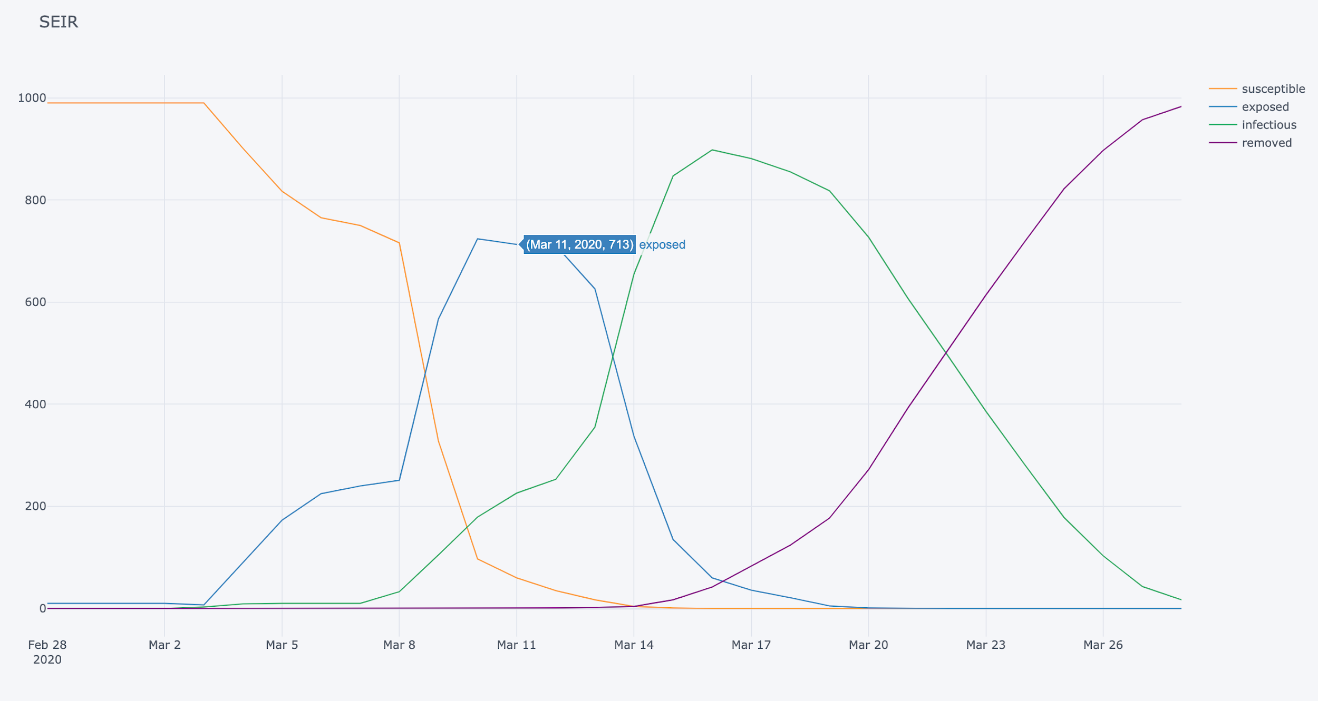
Epidemiology Metrics
Empowering Citizens against Covid-19 with an ML-Based and Decentralized Risk Awareness App

Slide 23
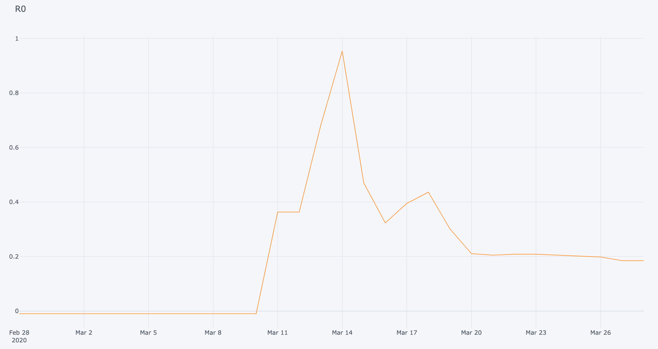
Epidemiology Metrics
Empowering Citizens against Covid-19 with an ML-Based and Decentralized Risk Awareness App

Slide 24
Conclusions
By using ML-based digital tracing, we can get the best of both worlds between digital and manual tracing
Aggregation of many weak clues to predict risk
Fast, informed interventions
We can do this without compromising on privacy or human rights and dignities
Mixnet cryptographic protocol
Train ML predictors on epidemiologically-informed simulated data
App priorities:
Privacy & security
Individual empowerment and provision of information
Saving lives via early intervention
Simulator provides a research tool for public health authorites & epidemiologists
Empowering Citizens against Covid-19 with an ML-Based and Decentralized Risk Awareness App

Slide 25
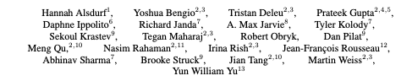
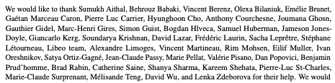
Collective Effort (over 60 persons)

Slide 26
Risk Awareness App: Current status
Empowering Citizens against Covid-19 with an ML-Based and Decentralized Risk Awareness App

Slide 27
Risk Awareness App: Near future
Empowering Citizens against Covid-19 with an ML-Based and Decentralized Risk Awareness App

Slide 28
Social mixing across the age groups

Slide 29
R0 = 2.55
Serial Interval = 5.80 days

Slide 30
R
Asymptomatic
1.67
R
Presymptomatic
2.61
R
Symptomatic
1.25

Slide 31
Senior Residency
1.77
Workplace
2.09
School
1.55
Hospital
1.08

Slide 32
Age group | Average daily contacts
1 - 15 | 28.01
15 - 20 | 33.24
20 - 40 | 33.28
40 - 60 | 30.95
60 - 80 | 50.89
Above 80 | 45.92

Slide 33
Mean Age
49.5
Mean Household size
2.63

Slide 34
Overall approach
Stochastic agent-based model

Slide 35
Human
Health
Age
Sex
Preexisting conditions (diabetes, heart disesase, asthma, COPD)
Has cold or flu
SEIR timestamp
Symptoms
Viral load
Status
Travelled recently
Carefullness profile
Has app
Wearing mask
Infectiousness
Household, workplace
Mobility
Working hours & conditions
Shopping profile
Exercise profile
Transit profile
Environment
Time (2h chunks)
Events
Encounter between 2 humans
Human symptoms updated
Human test results updated
City
Graph structure
Locations
Events
Encounter
Human1, human2
Distance
Duration
Location contamination
Locations
Households, parks, stores, misc.
Contamination probability (depends on humans + material properties)
Mobility
Humans move around the city to different locations according to their mobility profiles
Notes:
NOTE: R0 is not consistent with aerosol transfer (maybe make transmission p for air == 0) TODO: add residential care facilities, and hospitals (e.g. nursing homes) TODO: add special job for healthcare worker (+with covid patients == different parts of hospital, large difference in roles) TODO: different levels of mask-wearing (healthcare worker vs. average person) n.b. Reduces YOU transmitting, not receiving NOTE: data shows that removing infected people from household is very important for reducing R0 NOTE: in QC/other places the positive test may not be by an actual test, could be diagnosis based on symptom criteria + plausible transmission vector (NOT community transfer, ideally, but maybe not; ask public health) as of March 30, public health has the label of lab_result vs. epi_contact critera (not consistently recorded), due to wprldwide transfer of reagent for PCR. # lab tests is around 5% at most for new cases (since mar30), serosurveys will start soon (another kind of test) NOTE: if people are travelling again, for future, mobility patterns will change NOTE: grouping people together NOTE: gradations of location/distance (5-10, 10-20, 20-30, >30m don’t care)

Slide 36
Notes
Implemented in SimPY (python)
Will have real city information from Google Maps
Mobility information based on realistic trajectories

Slide 37
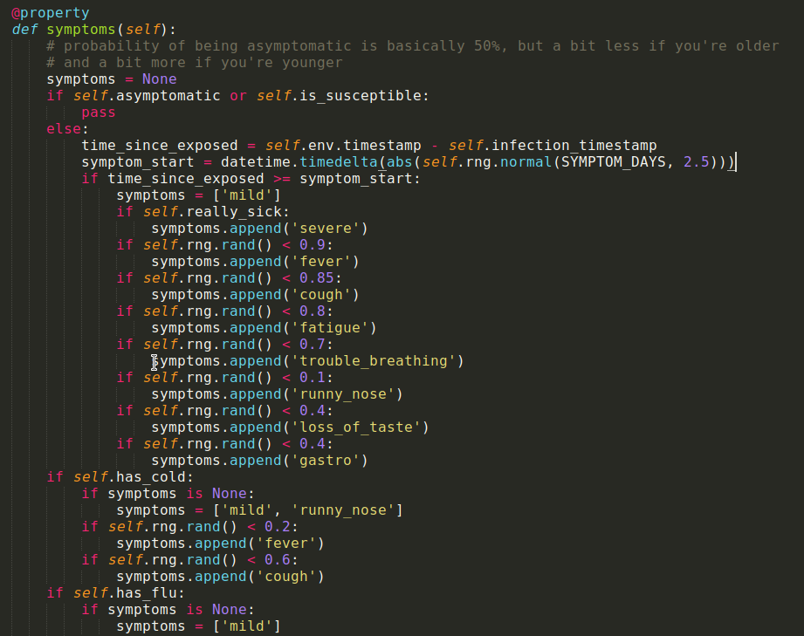
Symptoms

Slide 38
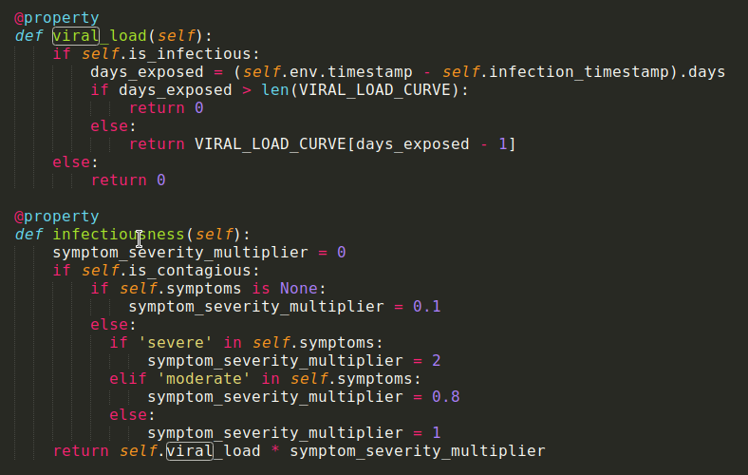
Viral load
& Infectious-ness
VIRAL_LOAD_CURVE is a discretized gamma with peak of ~30% at 2.5 days after exposure (infection)

Slide 39
Transmission probability
X_location (probability of being infected by the location = contamination probability)
X_human (probability of being infected by the other human = their infectiousness)
If either of these is true, you are infected

Slide 40
Validating simulator output
Metrics we’re tracking

Slide 41
SEIR

Slide 42
Ro

